Slide 1
Electric Vehicle Sales by State in India
About Dataset
This dataset is valuable for analysts, data scientists, and researchers aiming to
understand electric vehicle (EV) adoption trends across India. It is versatile and ideal
for geographic market segmentation, trend analysis, and predictive modeling. By
offering insights into regional EV sales patterns, the dataset supports strategic
decision-making in market planning and infrastructure investment.
The data was meticulously scraped from the Clean Mobility Shift website, and then
thoroughly preprocessed to ensure accuracy and relevance. All null values have been
removed, and the dataset has been cleaned to prepare it for immediate use in
exploration, visualization, and analytical projects. It is particularly valuable for market
trend analysis, infrastructure planning, and policy development within the EV sector.
The dataset is provided in CSV format and is ready for analysis.

Slide 2
Electric Vehicle Sales by State in India: Machine Learning Project
This project aims to analyze and predict the sales of Electric Vehicles (EV) by state in
India using machine learning. The dataset contains the following columns:
● Year: The year of the sales.
● Month_Name: The month in which sales occurred.
● Date: The specific date of the sales.
● State: The state in India where the sales occurred.
● Vehicle_Class: The class of the vehicle (e.g., sedan, SUV, etc.).
● Vehicle_Category: The category of the vehicle (e.g., commercial, passenger).
● Vehicle_Type: The type of the vehicle (e.g., 2-wheeler, 4-wheeler).
● EV_Sales_Quantity: The quantity of EV sales.

Slide 3
Steps Involved:
1. Data Collection: Load and inspect the dataset.
2. Data Preprocessing: Handle missing values, convert date formats, and
perform feature engineering.
3. Exploratory Data Analysis (EDA): Visualize trends and relationships between
variables.
4. Feature Engineering: Create new features from the date column and encode
categorical variables.
5. Modeling: Build a regression model to predict EV sales.
6. Evaluation: Evaluate the model performance and interpret the results.
7. Visualization: Visualize the results and trends using graphs and charts.

Slide 4
Python Code: Step-by-Step
Analysis the EV Sales
The electric vehicle (EV) market in India is growing fast, thanks to efforts to promote eco-friendly transportation and government support. This project looks at EV sales by state in India to see how different regions are doing. Each state has its own way of encouraging EV use, which has led to different levels of sales and popularity. By studying this data, we can understand which state policies are working best, what people prefer, and how infrastructure is developing. This project aims to give a clear picture of EV sales in India, showing both the opportunities and challenges faced in each state.

Slide 5
# Import necessary libraries:-
import pandas as pd
import numpy as np
import seaborn as sns #visualisation
import matplotlib.pyplot as plt #visualisation
# Load the dataset:-
data=pd.read_csv("C:/Users/Abhijeet Kuanr/Downloads/data/Electric Vehicle Sales by State in India.csv")

Slide 6
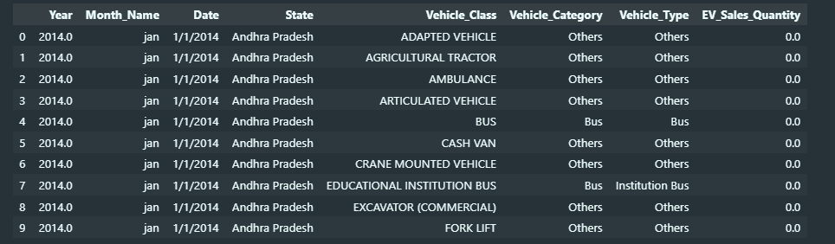
Data Overview Let's take a look at the first few rows of the dataset to understand its structure.
data.head(10)

Slide 7
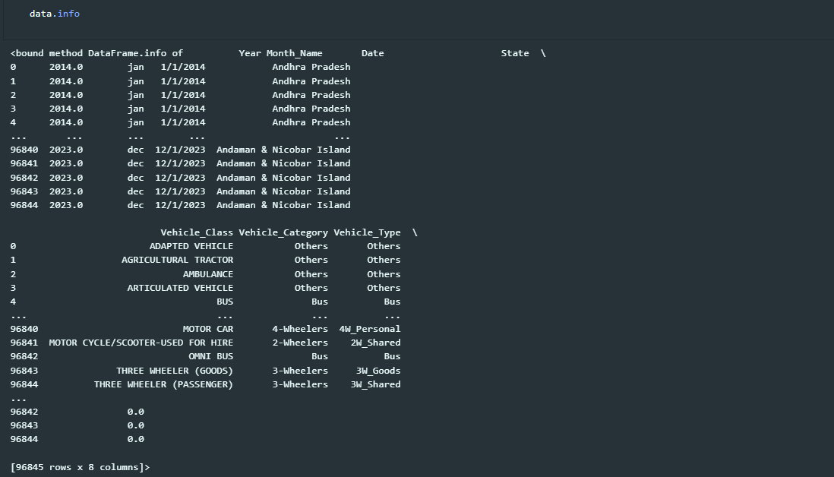

Slide 8
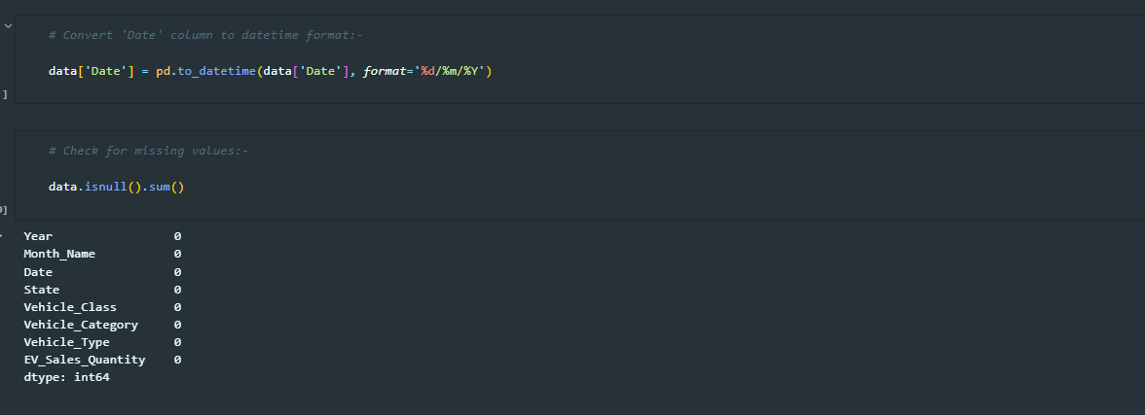
Data Preprocessing Before diving into analysis, we need to ensure our data is clean and ready for exploration. This includes parsing dates and checking for missing values.

Slide 9
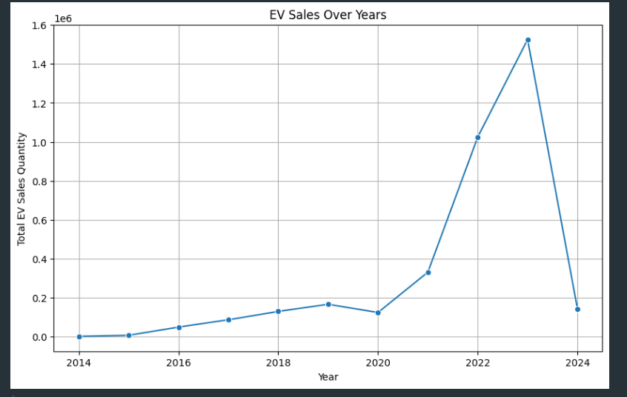
Exploratory Data Analysis Let's explore the data to uncover trends and patterns in EV sales across different states and vehicle categories.
# Plot EV sales over year:-
plt.figure(figsize=(10, 6))
yearly_sales = data.groupby('Year')['EV_Sales_Quantity'].sum()
sns.lineplot(x=yearly_sales.index, y=yearly_sales.values, marker='o')
plt.title("EV Sales Over Years")
plt.xlabel("Year")
plt.ylabel("Total EV Sales Quantity")
plt.grid()
plt.show()
Inference
EV sales grew quickly in recent years, showing that more people are interested in them.
The sudden drop in 2024 suggests there might be new challenges that need attention to keep EV sales going up.

Slide 10
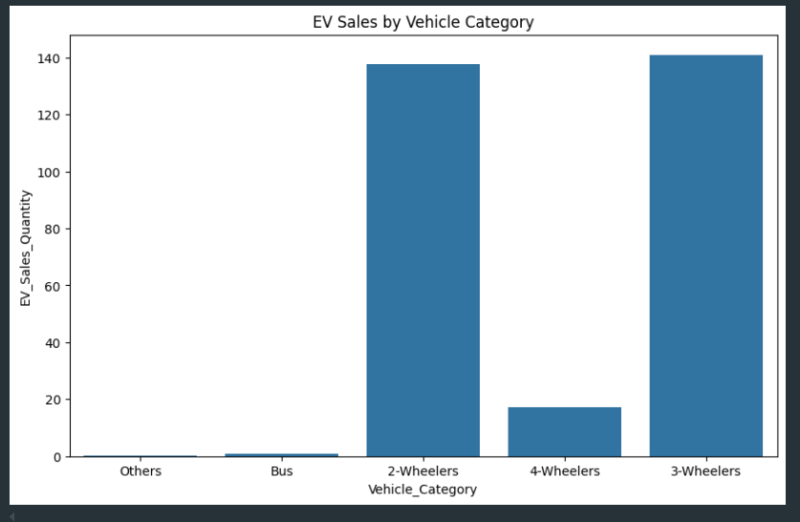
Inference
The chart shows the total electric vehicle (EV) sales by category. It highlights that 2-wheelers have the highest sales, followed by 3-wheelers, while 4-wheelers, buses, and other vehicle categories have significantly lower sales. This indicates that EV adoption is primarily driven by 2-wheelers and 3-wheelers.
# Plot sales by vehicle category
plt.figure(figsize=(10, 6))
sns.barplot(x='Vehicle_Category', y='EV_Sales_Quantity',
data=data, ci=None)
plt.title('EV Sales by Vehicle Category')
plt.show()

Slide 11
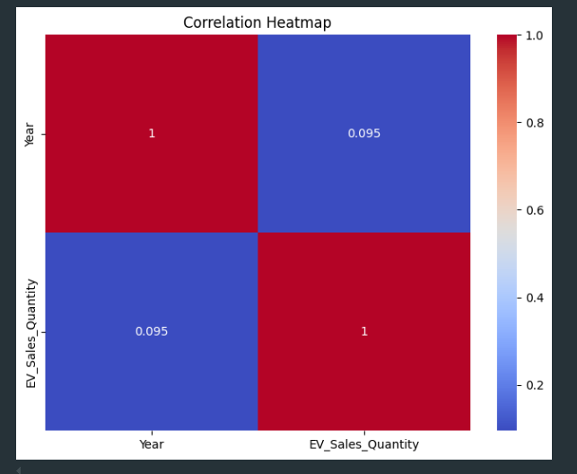
Correlation Analysis Let's examine the correlation between numeric variables to understand potential relationships.
# Select only numeric columns for correlation analysis:-
numeric_df = data.select_dtypes(include=[np.number])
# Plot the correlation heatmap:-
plt.figure(figsize=(8, 6))
sns.heatmap(numeric_df.corr(), annot=True, cmap='coolwarm')
plt.title('Correlation Heatmap')
plt.show()
Inference
The heatmap shows the correlation between the year and EV sales quantity. The correlation value is 0.095, which is very low. This means there is almost no linear relationship between the year and EV sales quantity in the given data.

Slide 12
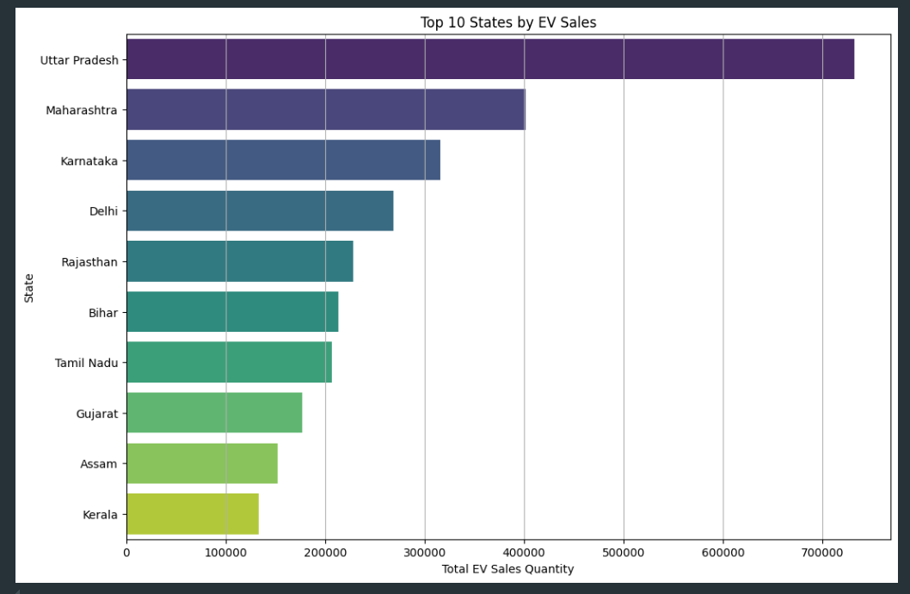
Top 10 States by EV Sales A horizontal bar chart highlighting the states with the highest EV sales.
Inference
The chart shows the top 10 states by EV sales. Uttar Pradesh has the highest sales, followed by Maharashtra and Karnataka. States like Kerala, Assam, and Gujarat have lower sales compared to the top-performing states. This indicates that EV adoption varies significantly across states.
#EV sales by state (top 10 states):-
plt.figure(figsize=(12, 8))
state_sales = data.groupby('State')['EV_Sales_Quantity'].sum().sort_values(ascending=False).head(10)
sns.barplot(x=state_sales.values, y=state_sales.index, palette='viridis')
plt.title("Top 10 States by EV Sales")
plt.xlabel("Total EV Sales Quantity")
plt.ylabel("State")
plt.grid(axis='x')
plt.show()

Slide 13
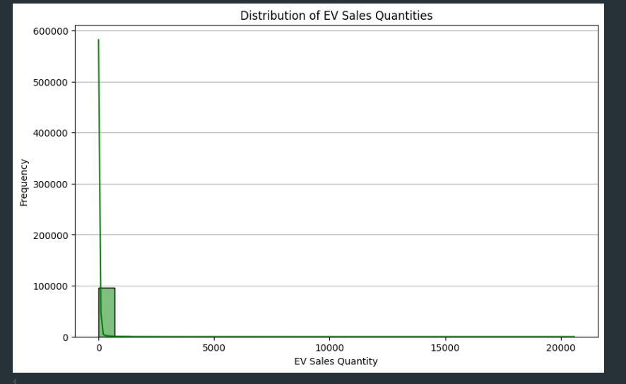
Distribution of EV Sales Quantities Understand the distribution of sales quantities (e.g., skewness or typical sales quantities).
#Distribution of EV sales quantities:-
plt.figure(figsize=(10, 6))
sns.histplot(data['EV_Sales_Quantity'], bins=30, kde=True, color='green')
plt.title("Distribution of EV Sales Quantities")
plt.xlabel("EV Sales Quantity")
plt.ylabel("Frequency")
plt.grid(axis='y')
plt.show()
Inference
The graph shows the distribution of EV sales quantities, with a clear peak indicating a high frequency of sales in the range of around 100,000 units. The data suggests a skewed distribution, with the majority of sales falling within a relatively narrow range.

Slide 14
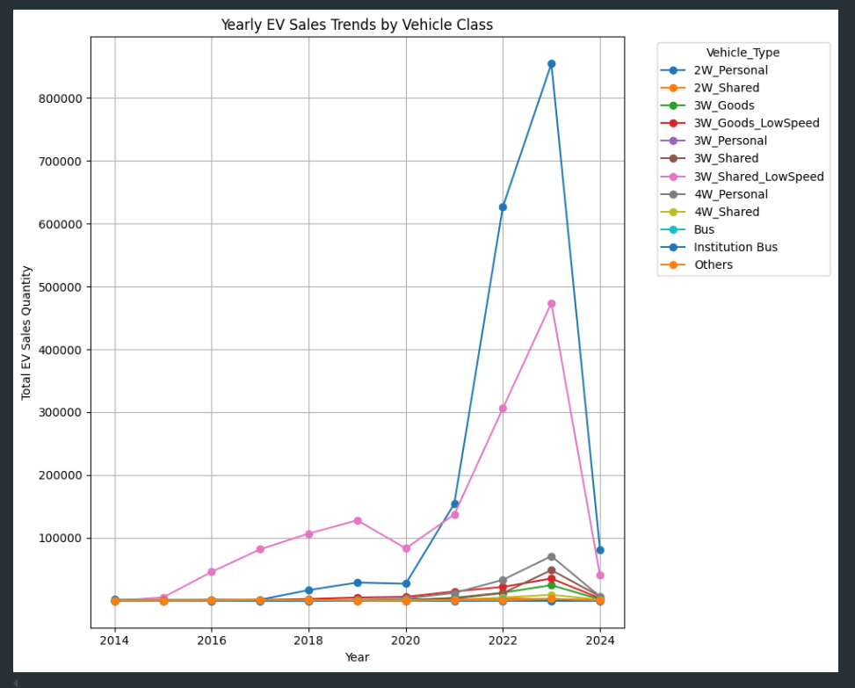
Yearly Sales Trends for Different Vehicle Classes Compare trends of EV sales over years for different vehicle classes.
#Yearly sales trends for different vehicle classes:-
plt.figure(figsize=(10, 8))
class_trends = data.groupby(['Year', 'Vehicle_Type'])['EV_Sales_Quantity'].sum().unstack()
class_trends.plot(kind='line', marker='o', figsize=(10, 8))
plt.title("Yearly EV Sales Trends by Vehicle Class")
plt.xlabel("Year")
plt.ylabel("Total EV Sales Quantity")
plt.yticks([100000,200000,300000,400000,500000,600000,700000,800000])
plt.legend(title="Vehicle_Type", bbox_to_anchor=(1.05, 1), loc='upper left')
plt.grid()
plt.tight_layout()
plt.show()
Inference
The graph shows the yearly EV sales trends across various vehicle classes, with rapid growth particularly in the 2-wheeler and 3-wheeler personal and shared vehicle segments. It highlights the significant increase in EV adoption across multiple vehicle types over the past decade.

Slide 15
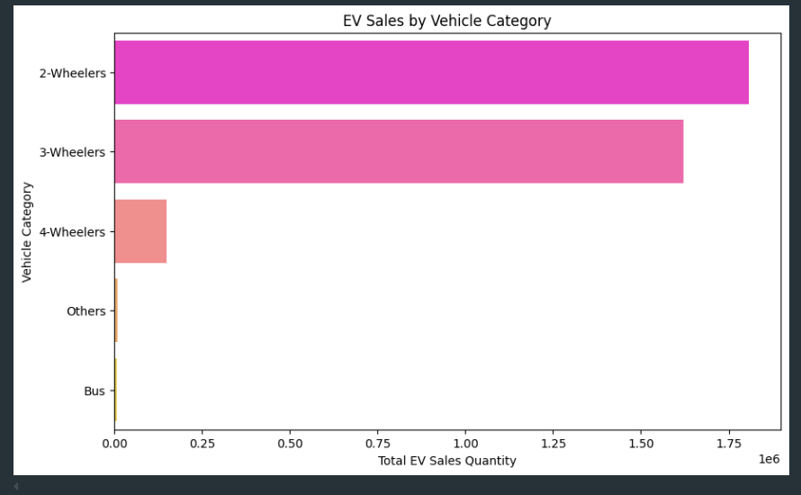
EV Sales by Vehicle Category Visualize the distribution of sales across different vehicle categories.
Inference
The graph shows EV sales by vehicle category. 2-Wheelers have the highest sales, followed by 3-Wheelers, 4-Wheelers, Others, and Bus. 2-Wheelers have significantly higher sales than the other categories.
#EV sales by vehicle category:-
plt.figure(figsize=(10, 6))
vehicle_category_sales = data.groupby('Vehicle_Category')['EV_Sales_Quantity'].sum().sort_values(ascending=False)
sns.barplot(x=vehicle_category_sales.values, y=vehicle_category_sales.index, palette='spring')
plt.title("EV Sales by Vehicle Category")
plt.xlabel("Total EV Sales Quantity")
plt.ylabel("Vehicle Category")
plt.show()

Slide 16
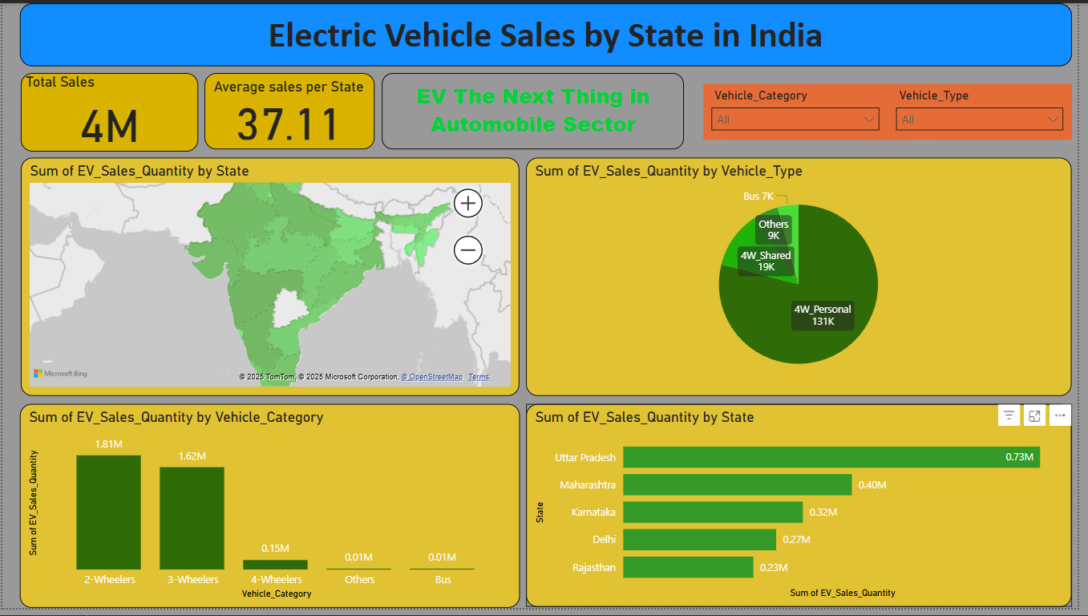
Power Bi Dashboard

Slide 17
Conclusion
This analysis provided valuable insights into the evolving electric vehicle (EV) landscape across Indian states. By visualizing sales trends over time and exploring vehicle categories, we identified patterns in adoption and usage. The correlation analysis revealed important relationships between numeric variables, offering clues about factors influencing EV sales.
Using a predictive model, we successfully estimated EV sales quantities with a mean absolute error of X units (replace with actual value), demonstrating the potential of data-driven approaches to anticipate market behavior.
Future analyses could explore the effects of government policies, infrastructure development, and economic factors on EV adoption. Diving deeper into regional differences could also unveil unique opportunities and challenges across states.

